Slide 1



Naming conventions
for data elements
DHIS2 Customization

Slide 2




Notes:
Creating new metadata in DHIS2 is often a straightforward process that can be done quickly via the user interface.

Slide 3



Notes:
However, one of the challenges of setting up a functional DHIS2 system is that many people can potentially contribute to it by adding or modifying these metadata. Without close coordination between those users,...

Slide 4
Not found
Notes:
...we can end up with a system that is difficult to navigate and where it is hard to find what you need.

Slide 5
In this video, you will see…
How to follow a clear standard for naming metadata
Notes:
In this video, you will learn about one crucial aspect of maintaining a well-functioning DHIS2 system, following clear standards for naming metadata.

Slide 6
Stardardized method of naming
Data elements
Name
Notes:
Let's take data elements as an example. When creating new data elements, a standardized method of naming them should be followed by all users of the system.

Slide 7




Stardardized method of naming
Data elements
Notes:
This will mean some coordination both within and between different programs or services as necessary.

Slide 8
Where no protocols are being followed…
Can’t locate items
May create duplicate copies
Leads to system clutter
Notes:
Where no protocols are being followed, the users may find it difficult to locate the items they need. If they can't locate items, they may create duplicate copies of them out of a belief that they do not already exist in the system, leading to system clutter and confusion for other users over which of the duplicate items is the correct one to use.

Slide 9
Where no protocols are being followed…
Notes:
This issue will compound itself over time as more data elements are added to DHIS2. To prevent this issue, you can apply some key principles to make it easier for end users to locate the data elements they need.

Slide 10
Naming principles
Principle #1
Avoid unnecesary information
Number of Malaria Nets Distributed
Data elements typically have numerical values
Notes:
The first principle is to avoid unnecessary information. For example, there is usually no need to include phrases such as number of in data elements. Remember that data elements typically have numerical values, so we can assume it refers to a number, unless otherwise stated.

Slide 11
Naming principles
Principle #2
Put the key information early in the name
Malaria cases positive
Positive Malaria cases
Will sort all Malaria related elements
Notes:
The second principle is to put the key information early in the name. For example, we should say malaria cases positive, instead of positive malaria cases. Why does this matter? Putting malaria first will help us sort all of the malaria program-related elements instead of all the positive cases from different diseases.

Slide 12
Naming principles
Principle #3
Be explicit about the program the data element belongs to
Case incidence rate per 100 000 population
Malaria incidence rate per 100 000 population
Malaria?
Tuberculosis?
Cholera?
Notes:
The third principle is to be explicit about the program that the data element belongs to if it could belong to more than one. Because DHIS2 is an integrated system with information from many different types of data, it is necessary to be explicit about the area or program for each data element or indicator.
For example, the indicator case incidence rate per 100,000 population is unclear because it could refer to malaria, TB, cholera or other programs. We should put the specific health program at the start of the indicator name to make it clear which one it refers to.

Slide 13
Example: Applying good naming practices
Number of pregnant women who attend their first ANC visit
Notes:
Let's see what this looks like with an example. We would like to apply good practices to the naming of the data element "number of pregnant women who attended their first antenatal care visit".

Slide 14
Example: Applying good naming practices
Exclude unnecessary information:
Number of pregnant women who attend their first ANC visit
Notes:
First, we can exclude number of. We understand that we are referring to numbers in the realm of aggregate data collection unless specified otherwise. We also don't need to mention pregnant women in the name at all since antenatal care visits only concern pregnant woman. We can also cut out who attend their as it is assumed.

Slide 15
Example: Applying good naming practices
Exclude unnecessary information:
Short
Simple
First ANC visit
Notes:
By cutting any unnecessary words, we can keep it short and simple.

Slide 16
Example: Applying good naming practices
Exclude unnecessary information:
Want to retain more information?
Use the description field
First ANC visit
Notes:
If we decide that we want to retain more descriptive information about the data element, we can include in the description field instead of the name.

Slide 17
Example: Applying good naming practices
Exclude unnecessary information
Put key information first
First ANC visit
Notes:
Second, identify the key information and put it at the beginning of the name.
After cutting the words down, we are left with first ANC visit. Let's think about the particular order of the words "first and ANC visit.

Slide 18
Example: Applying good naming practices
Exclude unnecessary information
Put key information first
First ANC visit
First of a series of visits
Notes:
Let's think about the particular order of the words "first and ANC visit. Conventionally, first ANC visit would be the fist of a series of visits.

Slide 19
Example: Applying good naming practices
Exclude unnecessary information
Put key information first
First ANC visit
Data elements
Applied to DHIS2
First ANC visit
Second ANC visit
Third ANC visit
Fourth ANC visit
First ANC visit
Fourth ANC visit
Second ANC visit
Third ANC visit
Notes:
There would likely be additional related data elements, for example, first ANC visit, second ANC visit, third ANC visit and fourth ANC visit.
Although this makes sense in plain language, when applied to DHIS2, this might not work as well because the data elements in DHIS2 are alphabetically ordered. It means that in a list of data elements, they would appear in this order. First ANC visit, fourth ANC visit, second ANC visit and third ANC visit.

Slide 20
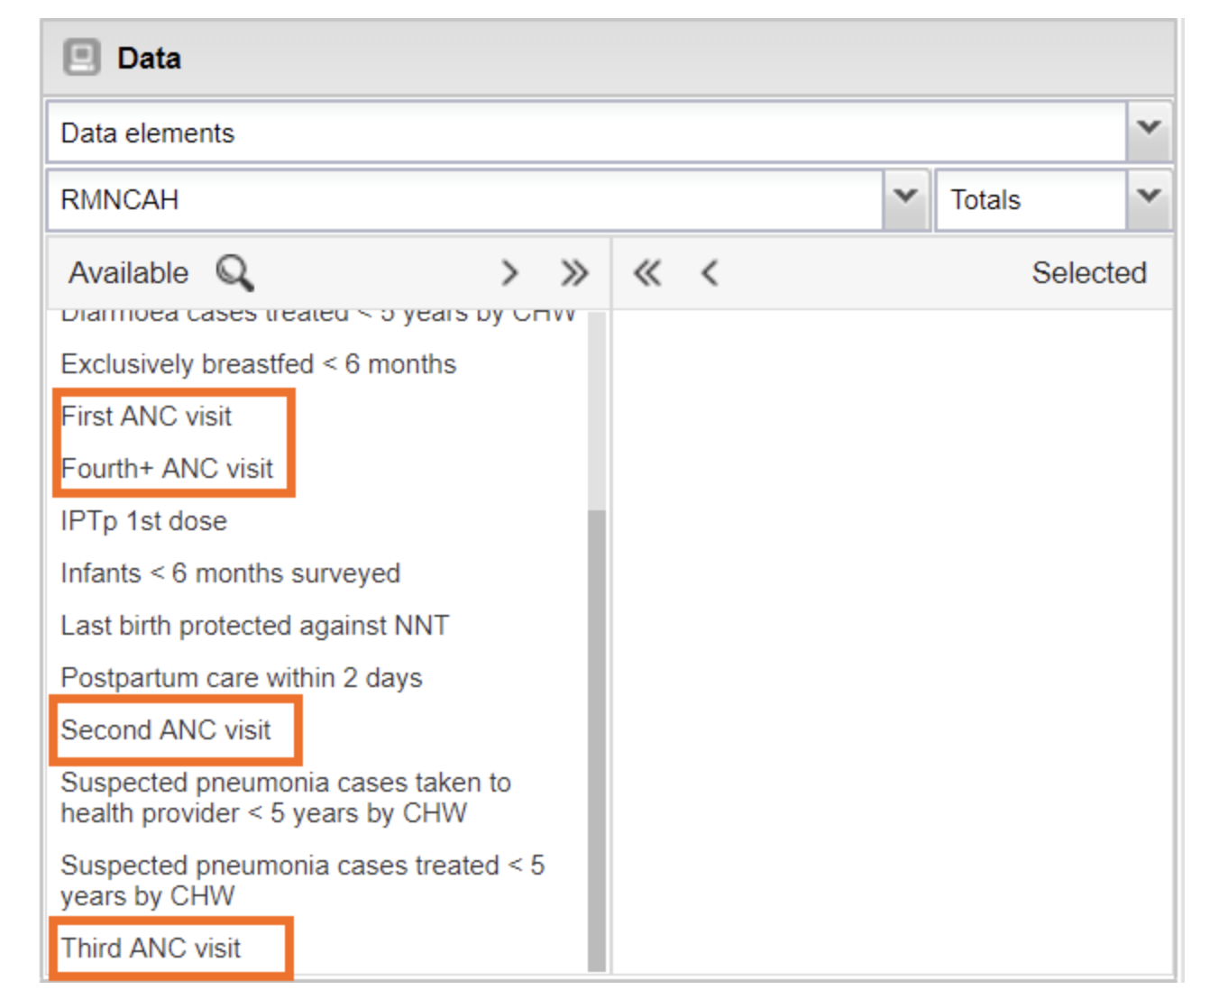
Example: Applying good naming practices
Recommendation
Keep related data elements together
Elements might be harder to find
Notes:
If there are many other elements in your system, your ANC elements might end up separated in a list and would be harder to find. We recommend keeping related data elements together, where possible.

Slide 21
Example: Applying good naming practices
Exclude unnecessary information
Put key information first
First ANC visit
Second ANC visit
Third ANC visit
Fourth ANC visit
ANC First visit
ANC Second visit
ANC Third visit
ANC Fourth visit
Notes:
We can change the name of these elements so they start with the essential part of the name. Let's put ANC first. So we get ANC first visit, ANC second visit, ANC third visit, and ANC fourth visit. This will allow the items to appear together.

Slide 22
Example: Applying good naming practices
Exclude unnecessary information
Put key information first
ANC First visit
ANC Fourth visit
ANC Second visit
ANC Third visit
Notes:
However, they still won't be in the correct visit order. To ensure they are in the visit order, we can change the words first, second, third, fourth to numerical abbreviations so we have:...

Slide 23
Example: Applying good naming practices
Exclude unnecessary information
Put key information first
ANC 1st visit
ANC 2nd visit
ANC 3rd visit
ANC 4th visit
Notes:
...ANC 1st visit, using the 1st instead of the word first, ANC 2nd visit, spelled 2nd, and so on for the third and fourth.

Slide 24
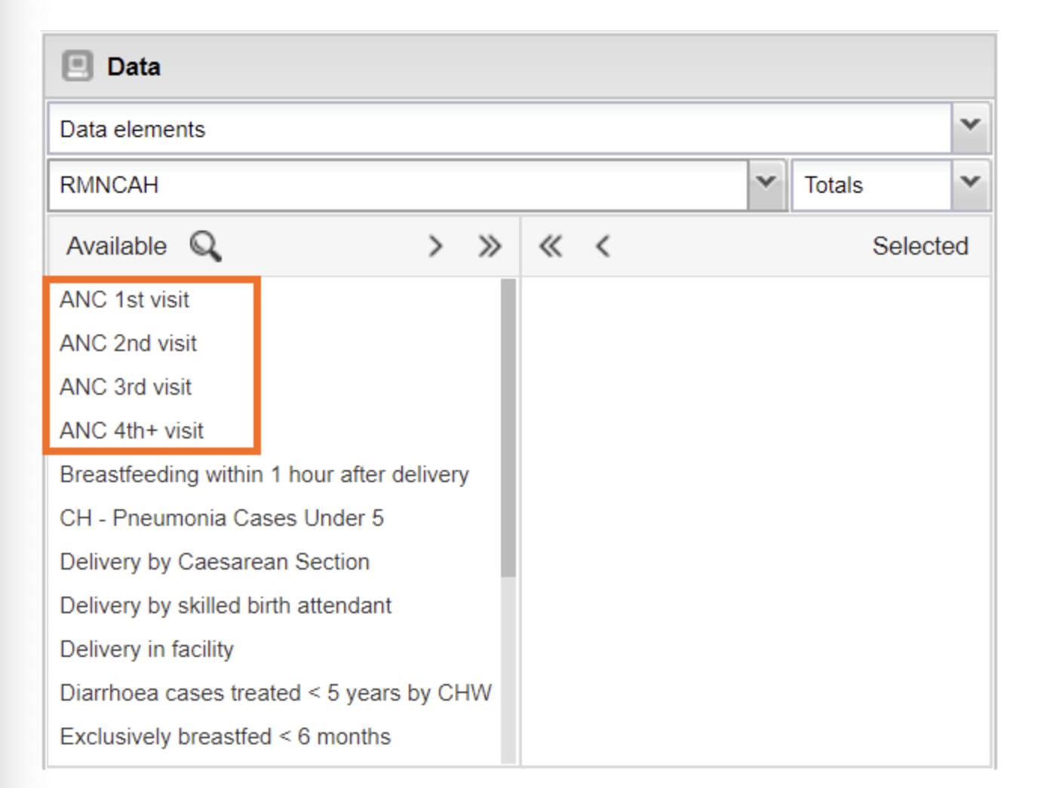
Example: Applying good naming practices
Exclude unnecessary information
Put key information first
ANC 1st visit
ANC 2nd visit
ANC 3rd visit
ANC 4th visit
Notes:
With this final change, the data elements will be correctly ordered from first to last and will be kept together as a group within an alphabetically ordered list.

Slide 25
Example: Applying good naming practices
Exclude unnecessary information
Put key information first
ANC 1st visit
ANC 2nd visit
ANC 3rd visit
ANC 4th visit
Reproductive, Maternal, Newborn, Child and Adolescent Health
RMNCAH
Notes:
Lastly, we could add a prefix that indicates the program this data element belong to. Since this element belongs to the reproductive, maternal, newborn, child and adolescent health program, RMNCAH in short, we can add the prefix RMNCAH to the data element.

Slide 26
Example: Applying good naming practices
Exclude unnecessary information
Put key information first
RMNCAH
ANC 1st visit
Notes:
We would then have RMNCAH ANC 1st visit.

Slide 27
Example: Applying good naming practices
Exclude unnecessary information
Put key information first
RMNCAH
ANC 1st visit
RMNCAH
ANC 2nd visit
Easily find and group data elements
RMNCAH
ANC 3rd visit
RMNCAH
ANC 4th visit
Notes:
In particular, this will assist system administrators as it will allow them to find and group data elements together for various maintenance operations.

Slide 28

Summary
When using different procedures for naming metadata
System that is difficult to use
Naming conventions best practices:
Avoid unnecessary information
Put the key information early in the name
Use the same prefix for related elements to keep them together
4. Include a program prefix before the name of each data element
Notes:
In summary, when programs, services and individuals use different procedures for naming data elements and other metadata in the system, the result is often a system that is difficult to use. Using naming conventions when creating metadata can help mitigate these issues. These best practices include avoid unnecessary information. Put the important information early in the name. Use the same prefix for related data elements to keep them together. And include a program prefix before the name of each data element.

